Slide 1
Querying and Indexing

Slide 2
Querying
Tuning query techniques and parameters to make the most efficient use of a globally distributed database service.
This module will reference querying in the context of the SQL API for Azure Cosmos DB

Slide 3
Query Tuning (1 of 2)
MULTIPLE THINGS CAN IMPACT THE PERFORMANCE OF A QUERY RUNNING IN AZURE COSMOS DB. A FEW IMPORTANT QUERY PERFORMANCE FACTORS INCLUDE:
Provisioned throughput
Measure RU per query, and ensure that you have the required provisioned throughput for your queries
Partitioning and partition keys
Favor queries with the partition key value in the filter clause for low latency
SDK and query options
Follow SDK best practices like direct connectivity, and tune client-side query execution options

Slide 4
Query Tuning (2 of 2)
MANY THINGS CAN IMPACT THE PERFORMANCE OF A QUERY RUNNING IN AZURE COSMOS DB. IMPORTANT PERFORMANCE FACTORS INCLUDE:
Network latency
Account for network overhead in measurement, and use multi-homing APIs to read from the nearest region
Indexing Policy
Ensure that you have the required indexing paths/policy for the query
Query Complexity
Use simple queries to enable greater scale.
Query execution metrics
Analyze the query execution metrics to identify potential rewrites of query and data shapes
Notes:
Query Complexity: avoid using complex queries (such as MongoDB aggregation pipeline) whenever simpler queries are possible (such as find/SELECT with filter condition). Simpler queries scale much better.

Slide 5
Client Query Parallelism
CROSS-PARTITOIN QUERIES CAN BE PARRALELIZED TO USE AS MANY THREADS AS POSSIBLE
Modern processors ship with both physical and virtual (hyper-threading) cores. For any given cross-partition query, the SDK can use concurrent threads to issue the query across the underlying partitions.
By default, the SDK uses a slow start algorithm for cross-partition queries, increasing the amount of threads over time. This increase is exponential up to any physical or network limitations.
Primary Thread
Concurrent Thread
DOP = 4
Concurrent Thread
Query Thread
DOP = 1
Concurrent Thread

Slide 6
Client REsponse Buffer
2
First Request
1
3
First Response
6
4
Concurrent Request
5
Client Buffer
Concurrent Response
Notes:
The client device’s code using an SDK to issue a request
The SDK issues the first request for query results to the Azure Cosmos DB service
The Azure Cosmos DB service returns the first set of results to be processed by the client (serialization, etc)
While the client is processing the first set of results, a concurrent request is sent to pre-fetch additional results
The items returned as a response of the current request are then stored in a client-side buffer
Buffered items are processed by the client SDK

Slide 7
SDK Query Options (1 of 2)
ACHIEVING OPTIMAL PERFORMANCE IS OFTEN A BALANCING ACT BETWEEN THESE TWO PROPERTIES
Decreased Thread Usage
Slower Performance
Increased Thread Usage
Faster Performance
0
Max Degree of Parallelism
∞
Smaller Memory Footprint
Slower Performance
Larger Memory Footprint
Faster Performance
0
Max Buffered Item Count
∞

Slide 8
SDK Query Options (2 of 2)
Setting | Value | Effect
MaxDegreeofParallelism | -1 | The system will automatically decide the number of items to buffer
MaxDegreeofParallelism | 0 | Do not add any additional concurrent threads
MaxDegreeofParallelism | >= 1 | Add the specified number of additional concurrent threads
MaxBufferedItemCount | -1 | The system will automatically decide the number of concurrent operations to run
MaxBufferedItemCount | 0 | Do not maintain a client-side buffer
MaxBufferedItemCount | >= 1 | Specify the maximum size (items) of the client-side buffer

Slide 9
Request Units (1 of 3)
Request Units (RUs) is a rate-based currency
Abstracts physical resources for performing requests
Key to multi-tenancy, SLAs, and COGS efficiency
Foreground and background activities
% Memory
% CPU
% IOPS

Slide 10
Request Units (2 of 3)
Normalized across various access methods
1 RU = 1 read of 1 KB document
Each request consumes fixed RUs
Applies to reads, writes, query, and stored procedures
GET
=
POST
=
PUT
=
Query
=
…

Slide 11
Request Units (3 of 3)
Provisioned in terms of RU/sec
Rate limiting based on amount of throughput provisioned
Can be increased or decreased instantaneously
Metered Hourly
Background processes like TTL expiration, index transformations scheduled when quiescent
Rate limit
Max RU/sec
Incoming Requests
No rate limiting
Min RU/sec
Replica Quiescent
Notes:
We want to avoid throttling (rate limiting)

Slide 12
Measuring RU CHARGE (1 of 2)
ANALYZE QUERY COMPLEXITY
The complexity of a query impacts how many Request Units are consumed for an operation. The number of predicates, nature of the predicates, number of system functions, and the number of index matches / query results all influence the cost of query operations.
MEASURE QUERY COST
To measure the cost of any operation (create, update, or delete):
Inspect the x-ms-request-charge header
Inspect the RequestCharge property in ResourceResponse or FeedResponse in the SDK
NUMBER OF INDEXED TERMS IMPACTS WRITE RU CHARGES
Every write operation will require the indexer to run. The more indexed terms you have, the more indexing will be directly having an effect on the RU charge.
You can optimize for this by fine-tuning your index policy to include only fields and/or paths certain to be used in queries.

Slide 13
Measuring RU CHARGE (2 of 2)
STABILIZED LOGICAL CHARGES
Azure Cosmos DB uses information about past runs to produce a stable logical charge for the majority of CRUD or query operations.
Since this stable charge exists, we can rely on our operations having a high degree of predictability with very little variation. We can use the predictable RU charges for future capacity planning.
BULK OF QUERY RU CHARGES IS IO
Query RU is directly proportional to the quantity of query results.
Notes:
Azure Cosmos DB uses ML to produce a stable logical charge for vast majority of operations (CRUD and query). This gives a high degree of predictability for capacity planning (if creating document X costs 5 RU’s today, we can rely on the fact that it will cost 5 RU’s tomorrow). This isolates RU charge from variability in physical resource utilization due to other noisy processes like garbage collection

Slide 14
RU Charge Measurement Example (1 of 3)
ResourceResponse<Document> response = await client.CreateDocumentAsync(
collectionLink,
document
);
var requestUnits = response.RequestCharge;

Slide 15

RU Charge Measurement Example (2 of 3)
client.createDocument(
collectionLink,
documentDefinition,
function (err, document, headers) {
if (err) {
console.log(err);
}
var requestData = headers['x-ms-request-charge'];
}
);

Slide 16

RU Charge Measurement Example (3 of 3)
ResourceResponse<Document> response = client.createDocument(
collectionLink,
documentDefinition,
null,
false
);
Double requestCharge = response.getRequestCharge();

Slide 17


Request Unit Pricing Example
Storage Cost
Avg Record Size (KB)
1
Number of Records
100,000
Total Storage (GB)
100
Monthly Cost per GB
$0.25
Expected Monthly Cost for Storage
$25.00
Throughput Cost
Operation Type | Number of Requests per Second | Avg RU's per Request | RU's Needed
Create | 100 | 5 | 500
Read | 400 | 1 | 400
Total RU/sec
900
Monthly Cost per 100 RU/sec
$6.00
Expected Monthly Cost for Throughput
$54.00
Total Monthly Cost
[Total Monthly Cost] = [Monthly Cost for Storage] + [Monthly Cost for Throughput]
= $25 + $54
= $79 per month
* pricing may vary by region; for up-to-date pricing, see: https://azure.microsoft.com/pricing/details/cosmos-db/

Slide 18
DEMO Tuning a Query

Slide 19
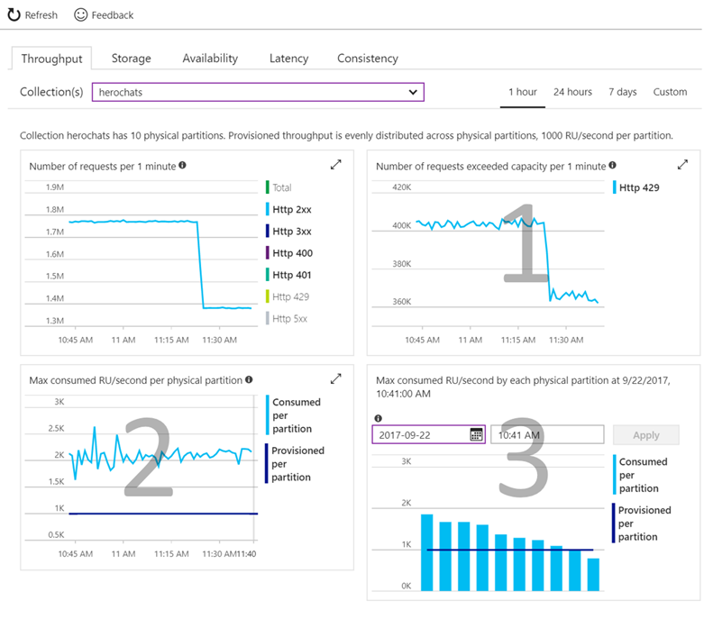
Validating THROUGHPUT LEVEL Choice
Check if your operations are getting rate limited.
Requests exceeding capacity chart
Check if consumed throughput exceeds the provisioned throughput on any of the physical partitions
Max RU/second consumed per partition chart
Select the time where the maximum consumed throughput per partition exceeded provisioned on the chart
Max consumed throughput by each partition chart
Notes:
Check if your operations are getting throttled.
Look at the "Requests exceeding capacity" chart on the throughput tab.
Check if consumed throughput exceeds the provisioned throughput on any of the physical partitions
Look at the "Max RU/second consumed per partition" metric.
Select the time where the maximum consumed throughput per partitions exceeded provisioned on the chart
Look at the "Max consumed throughput by each partition" chart

Slide 20

Cross-Partition Aggregate
LOW-LATENCY AGGREGATION WORKS ACROSS MULTIPLE PARTITIONS
You can submit a simple SQL query and Azure Cosmos DB handles the routing of the query among data partitions and merges results to return the final aggregate values.
SELECT VALUE
COUNT(1)
FROM
telemetry t
WHERE
t.deviceId = "craft267_seat17"
Example – Contoso Connected Car
Notes:
Regardless of the size or number of partitions in your collection, you can submit a simple SQL query and Azure Cosmos DB handles the routing of the query among data partitions, runs it in parallel against the local indexes within each matched partition, and merges intermediate results to return the final aggregate values.

Slide 21
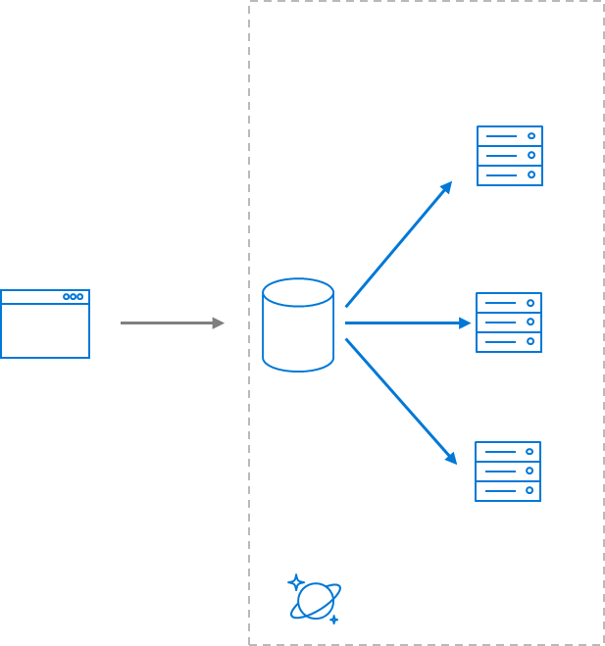
Bounded Location Search Using Geo-Data
{
"type":"Point",
"coordinates":[ 31.9, -4.8 ]
}
{
"type":"Polygon",
"coordinates":[[
[ 31.8, -5 ],
[ 31.8, -4.7 ],
[ 32, -4.7 ],
[ 32, -5 ],
[ 31.8, -5 ]
]]
}
GEOJSON SPECIFICATION
Azure Cosmos DB supports indexing and querying of geospatial point data that's represented using the GeoJSON specification.
SEARCH BY DISTANCE FROM POINT
The ST_DISTANCE built-in function returns the distance between the two GeoJSON Point expressions.
SEARCH WITHOUT BOUNDED POLYGON
The ST_WITHIN built-in function returns a Boolean indicating whether the first GeoJSON Point expression is within a GeoJSON Polygon expression.
Notes:
GeoJSON data structures are always valid JSON objects, so they can be stored and queried using Azure Cosmos DB without any specialized tools or libraries. The Azure Cosmos DB SDKs provide helper classes and methods that make it easy to work with spatial data.
Both the ST_DISTANCE and ST_WITHIN functions can be used with Polygons and LineStrings in addition to Points.
f you include spatial indexing in your indexing policy, then "distance queries" will be served efficiently through the index. For more details on spatial indexing, see the section below. If you don't have a spatial index for the specified paths, you can still perform spatial queries by specifying x-ms-documentdb-query-enable-scan request header (or FeedOptions.EnableScanInQuery using the SDK) with the value set to "true".

Slide 22
Distance from Center Point Search
SELECT *
FROM flights f
WHERE ST_DISTANCE(f.origin.location, {
"type": "Point",
"coordinates": [-122.19, 47.36]
}) < 100 * 1000
ST_DISTANCE
ST_DISTANCE can be used to measure the distance between two points. Commonly this function is used to determine if a point is within a specified range (meters) of another point.

Slide 23
Polygon Shape Search
SELECT *
FROM flights f
WHERE ST_WITHIN(f.destination.location, {
"type": "Polygon",
"coordinates": [[
[-124.63, 48.36],
[-123.87, 46.14],
[-122.23, 45.54],
[-119.17, 45.95],
[-116.92, 45.96],
[-116.99, 49.00],
[-123.05, 49.02],
[-123.15, 48.31],
[-124.63, 48.36]
]]
})
ST_WITHIN
ST_WITHIN can be used to check if a point lies within a Polygon. Commonly Polygons are used to represent boundaries like zip codes, state boundaries, or natural formations.
Polygon arguments in ST_WITHIN can contain only a single ring, that is, the Polygons must not contain holes in them.
Notes:
Again if you include spatial indexing in your indexing policy, then "within" queries will be served efficiently through the index.

Slide 24
Handle any data with no schema or indexing required (2 of 2)
Azure Cosmos DB’s schema-less service automatically indexes all your data, regardless of the data model, to delivery blazing fast queries.
Automatic index management
Synchronous auto-indexing
No schemas or secondary indices needed
Works across every data model
GEEK
Item | Color | Microwave safe | Liquid capacity | CPU | Memory | Storage
Geek mug | Graphite | Yes | 16ox | ??? | ??? | ???
Coffee Bean mug | Tan | No | 12oz | ??? | ??? | ???
Surface book | Gray | ??? | ??? | 3.4 GHz Intel Skylake Core i7-6600U | 16GB | 1 TB SSD
Notes:
At global scale, schema/index management is hard
Automatic and synchronous indexing of all ingested content - hash, range, geo-spatial, and columnar
No need to define schemas or secondary indices upfront
Resource governed, write optimized database engine with latch free and log structured techniques
Online and in-situ index transformations

Slide 25
INDEXING JSON Documents (1 of 3)
{
"locations": [
{
"country": "Germany",
"city": "Berlin"
},
{
"country": "France",
"city": "Paris"
}
],
"headquarter": "Belgium",
"exports": [
{ "city": "Moscow" },
{ "city": "Athens" }
]
}
locations
headquarter
exports
0
1
Belgium
0
1
country
city
country
city
city
city
Germany
Berlin
France
Paris
Moscow
Athens

Slide 26
INDEXING JSON Documents (2 of 3)
{
"locations": [
{
"country": "Germany",
"city": "Bonn",
"revenue": 200
}
],
"headquarter": "Italy",
"exports": [
{
"city": "Berlin",
"dealers": [
{ "name": "Hans" }
]
},
{ "city": "Athens" }
]
}
locations
headquarter
exports
0
Italy
0
1
country
city
revenue
city
dealers
city
Germany
Bonn
200
Berlin
0
name
Hans

Slide 27
INDEXING JSON Documents (3 of 3)
locations
headquarter
exports
locations
headquarter
exports
+
0
1
Belgium
0
1
0
Italy
0
1
country
city
country
city
city
city
country
city
revenue
city
dealers
city
Germany
Berlin
France
Paris
Moscow
Athens
Germany
Bonn
200
Berlin
0
Athens
name
Hans
Notes:
{
"locations": [
{
"country": "Germany",
"city": "Berlin"
},
{
"country": "France",
"city": "Paris"
}
],
"headquarter": "Belgium",
"exports": [
{ "city": "Moscow" },
{ "city": "Athens" }
]
}
{
"locations": [
{
"country": "Germany",
"city": "Bonn",
"revenue": 200
}
],
"headquarter": "Italy",
"exports": [
{
"city": "Berlin",
"dealers": [
{ "name": "Hans" }
]
},
{ "city": "Athens" }
]
}

Slide 28
Inverted Index
{1, 2}
{1, 2}
locations
{1, 2}
headquarter
{1, 2}
exports
{1, 2}
0
{1}
1
{1}
Belgium
{2}
Italy
{1, 2}
0
{1, 2}
1
{1, 2}
country
{1, 2}
city
{1, 2}
revenue
{1, 2}
country
{1, 2}
city
{1, 2}
city
{2}
dealers
{1, 2}
city
{1}
Berlin
{1}
France
{1}
Paris
{1}
Moscow
{1, 2}
Germany
{2}
Bonn
{2}
200
{2}
Berlin
{2}
0
{2}
Athens
{2}
name
{2}
Hans

Slide 29
Index POLICIES
CUSTOM INDEXING POLICIES
Though all Azure Cosmos DB data is indexed by default, you can specify a custom indexing policy for your collections. Custom indexing policies allow you to design and customize the shape of your index while maintaining schema flexibility.
Define trade-offs between storage, write and query performance, and query consistency
Include or exclude documents and paths to and from the index
Configure various index types
{
"automatic": true,
"indexingMode": "Consistent",
"includedPaths": [{
"path": "/*",
"indexes": [{
"kind": "Hash",
"dataType": "String",
"precision": -1
}, {
"kind": "Range",
"dataType": "Number",
"precision": -1
}, {
"kind": "Spatial",
"dataType": "Point"
}]
}],
"excludedPaths": [{
"path": "/nonIndexedContent/*"
}]
}
Notes:
Include or exclude documents and paths to and from the index
You can exclude or include specific documents in the index when you insert or replace the documents in the collection. You can also include or exclude specific JSON properties, also called paths, to be indexed across documents that are included in an index. Paths include wildcard patterns.
Configure various index types
For each included path, you can specify the type of index the path requires for a collection. You can specify the type of index based on the path's data, the expected query workload, and numeric/string “precision.”
Configure index update modes
Azure Cosmos DB supports three indexing modes: Consistent, Lazy, and None. You can configure the indexing modes via the indexing policy on an Azure Cosmos DB collection.

Slide 30
Online Index Transformations
ON-THE-FLY INDEX CHANGES
In Azure Cosmos DB, you can make changes to the indexing policy of a collection on the fly. Changes can affect the shape of the index, including paths, precision values, and its consistency model.
A change in indexing policy effectively requires a transformation of the old index into a new index.
v1 Policy
v2 Policy
New document writes (CRUD) & queries
t₀
t₁
PUT /colls/examplecollection { indexingPolicy: … }
GET /colls/examplecollection x-ms-index-transformation-progress: 100
Notes:
Index transformations are made online. This means that the documents indexed per the old policy are efficiently transformed per the new policy without affecting the write availability or the provisioned throughput of the collection. The consistency of read and write operations made by using the REST API, SDKs, or from within stored procedures and triggers is not affected during index transformation. There's no performance degradation or downtime to your apps when you make an indexing policy change.

Slide 31
Index Tuning
METRICS ANALYSIS
The SQL APIs provide information about performance metrics, such as the index storage used and the throughput cost (request units) for every operation. You can use this information to compare various indexing policies, and for performance tuning.
When running a HEAD or GET request against a collection resource, the x-ms-request-quota and the x-ms-request-usage headers provide the storage quota and usage of the collection.
You can use this information to compare various indexing policies, and for performance tuning.
Update Index Policy
View Headers
Query Collection
Index
Collection
Notes:
Update index policy
Query collection
View Results
Repeat Step 1

Slide 32
SQL SYNTAX
Using the popular query language, SQL, to access semi-structured JSON data.
This module will reference querying in the context of the SQL API for Azure Cosmos DB.

Slide 33
SQL QUERY SYNTAX
BASIC QUERY SYNTAX
The SELECT & FROM keywords are the basic components of every query.
SELECT
tickets.id,
tickets.pricePaid
FROM tickets
SELECT
t.id,
t.pricePaid
FROM tickets t
Notes:
https://www.documentdb.com/sql/demo

Slide 34
SQL QUERY SYNTAX - WHERE
FILTERING
WHERE supports complex scalar expressions including arithmetic, comparison and logical operators
SELECT
tickets.id,
tickets.pricePaid
FROM tickets
WHERE
tickets.pricePaid > 500.00 AND
tickets.pricePaid <= 1000.00
Notes:
https://www.documentdb.com/sql/demo

Slide 35
SQL QUERY SYNTAX - PROJECTION (1 of 2)
JSON PROJECTION
If your workloads require a specific JSON schema, Azure Cosmos DB supports JSON projection within its queries
SELECT {
"id": tickets.id,
"flightNumber": tickets.assignedFlight.flightNumber,
"purchase": {
"cost": tickets.pricePaid
},
"stops": [
tickets.assignedFlight.origin,
tickets.assignedFlight.destination
]
} AS ticket
FROM tickets
[
{
"ticket": {
"id": "6ebe1165836a",
"purchase": {
"cost": 575.5
},
"stops": [
"SEA",
"JFK"
]
}
}
]
Notes:
https://www.documentdb.com/sql/demo

Slide 36
SQL QUERY SYNTAX - PROJECTION (2 of 2)
SELECT VALUE
The VALUE keyword can further flatten the result collection if needed for a specific application workload
SELECT VALUE {
"id": tickets.id,
"flightNumber": tickets.assignedFlight.flightNumber,
"purchase": {
"cost": tickets.pricePaid
},
"stops": [
tickets.assignedFlight.origin,
tickets.assignedFlight.destination
]
}
FROM tickets
[
{
"id": "6ebe1165836a",
"purchase": {
"cost": 575.5
},
"stops": [
"SEA",
"JFK"
]
}
]
Notes:
https://www.documentdb.com/sql/demo

Slide 37
INTRA-DOCUMENT JOIN (1 of 4)
Azure Cosmos DB supports intra-document JOIN’s for de-normalized arrays
Let’s assume that we have two JSON documents in a collection:
{
"pricePaid": 575.5,
"assignedFlight": {
"number": "F125",
"origin": "SEA",
"destination": "JFK"
},
"seat": “12A",
"requests": [
"kosher_meal",
"aisle_seat"
],
"id": "6ebe1165836a"
}
{
"pricePaid": 234.75,
"assignedFlight": {
"number": "F752",
"origin": "SEA",
"destination": "LGA"
},
"seat": "14C",
"requests": [
"early_boarding",
"window_seat"
],
"id": "c4991b4d2efc"
}
We are interested in querying an array internal to the document
SQL

Slide 38
INTRA-DOCUMENT JOIN (2 of 4)
We can filter on a particular array index position without JOIN:
SELECT
tickets.assignedFlight.number,
tickets.seat,
ticket.requests
FROM
tickets
WHERE
ticket.requests[1] == "aisle_seat"
[
{
"number":"F125","seat":"12A",
"requests": [
"kosher_meal",
"aisle_seat"
]
}
]
SQL

Slide 39
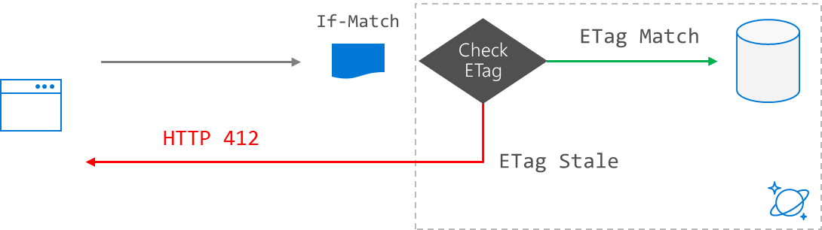
INTRA-DOCUMENT JOIN (3 of 4)
JOIN allows us to merge embedded documents or arrays across multiple documents and returned a flattened result set:
[
{
"number":"F125","seat":"12A",
"requests":"kosher_meal"
},
{
"number":"F125","seat":"12A",
"requests":"aisle_seat"
},
{
"number":"F752","seat":"14C",
"requests":"early_boarding"
},
{
"number":"F752","seat":"14C",
"requests":"window_seat"
}
]
SELECT
tickets.assignedFlight.number,
tickets.seat,
requests
FROM
tickets
JOIN
requests IN tickets.requests
SQL

Slide 40
INTRA-DOCUMENT JOIN (4 of 4)
Along with JOIN, we can also filter the cross products without knowing the array index position:
SELECT
tickets.id, requests
FROM
tickets
JOIN
requests IN tickets.requests
WHERE
requests
IN ("aisle_seat", "window_seat")
[
{
"number":"F125","seat":"12A“,
"requests": "aisle_seat"
},
{
"number":"F752","seat":"14C",
"requests": "window_seat"
}
]
SQL

Slide 41
Paginated Query Results (1 of 3)
Straightforward approach to paginate the results:
var query = client.CreateDocumentQuery<ExampleEntity>(collectionUri, options);
var docQuery = query.AsDocumentQuery();
List<ExampleEntity> results = new List<ExampleEntity>();
while (docQuery.HasMoreResults)
{
foreach (ExampleEntity item in await query.ExecuteNextAsync())
{
results.Add(item);
}
}

Slide 42
Paginated Query Results (2 of 3)
Pagination with ToList():
var query = client.CreateDocumentQuery<ExampleEntity>(collectionUri, options);
var docQuery = query.AsDocumentQuery();
List<ExampleEntity> results = new List<ExampleEntity>();
results = query.ToList();
ToList() automatically iterates through all pages

Slide 43
Paginated Query Results (3 of 3)
Pagination with hasNext() in Java:
Iterator<Document> documents = client.queryDocuments(
collectionLink,
queryString,
options
).getQueryIterator();
while(documents.hasNext()) {
Document current = documents.next();
}

Slide 44
SQL Query Parametrization
var query = client.CreateDocumentQuery<ExampleEntity>(collectionUri,
new SqlQuerySpec
{
QueryText = "SELECT * FROM dataset s WHERE (s.id = @id)",
Parameters = new SqlParameterCollection
{
new SqlParameter("@id", “exampleIdentifier")
}
}, options
);
List<ExampleEntity> results = new List<ExampleEntity>();
results = query.ToList<ExampleEntity>();

Slide 45
SQL QUERY In LINQ
var query = client.CreateDocumentQuery<ExampleEntity>(collectionUri, options);
var docQuery = query
.Where(s => s.LastName == "Andersen")
.Select(s => new { Name = s.LastName })
.AsDocumentQuery();
List<ExampleEntity> results = new List<ExampleEntity>();
results = query.ToList<ExampleEntity>();

Slide 46
Hands-On Exercise (2 of 5)
Tasks:
Executing Simple Queries
Querying AND iNDEXING Using SQL API

